Slide 1
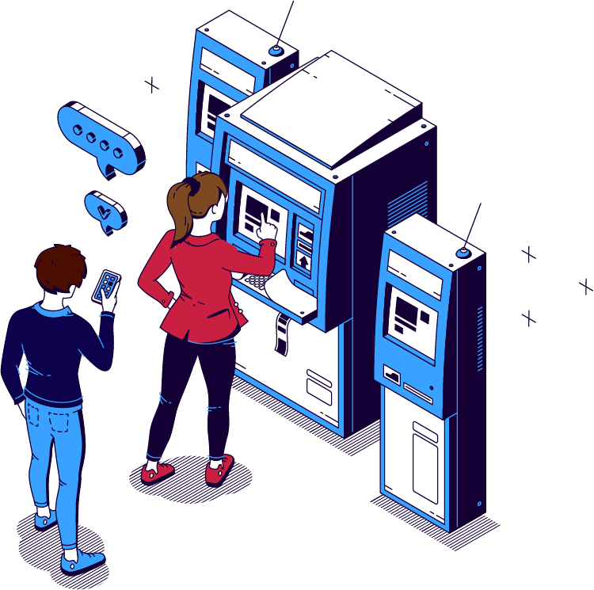
iGo
Ticket Vending Machine

Slide 2
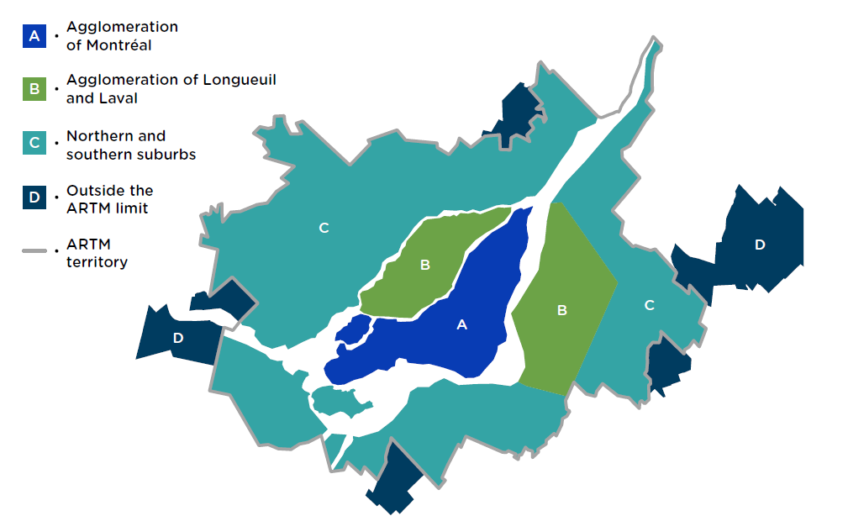
Public Transport Area
4 Fare Zones based on geographical location
4 Modes of Transport: Bus, MRT, Train and Water Shuttle

Slide 3

Types of Users
Regular Adult (18+ years)
Kids and Adolescent (6-17 years)
Students (18+ years)
Senior Citizen (65+ years)

Slide 4
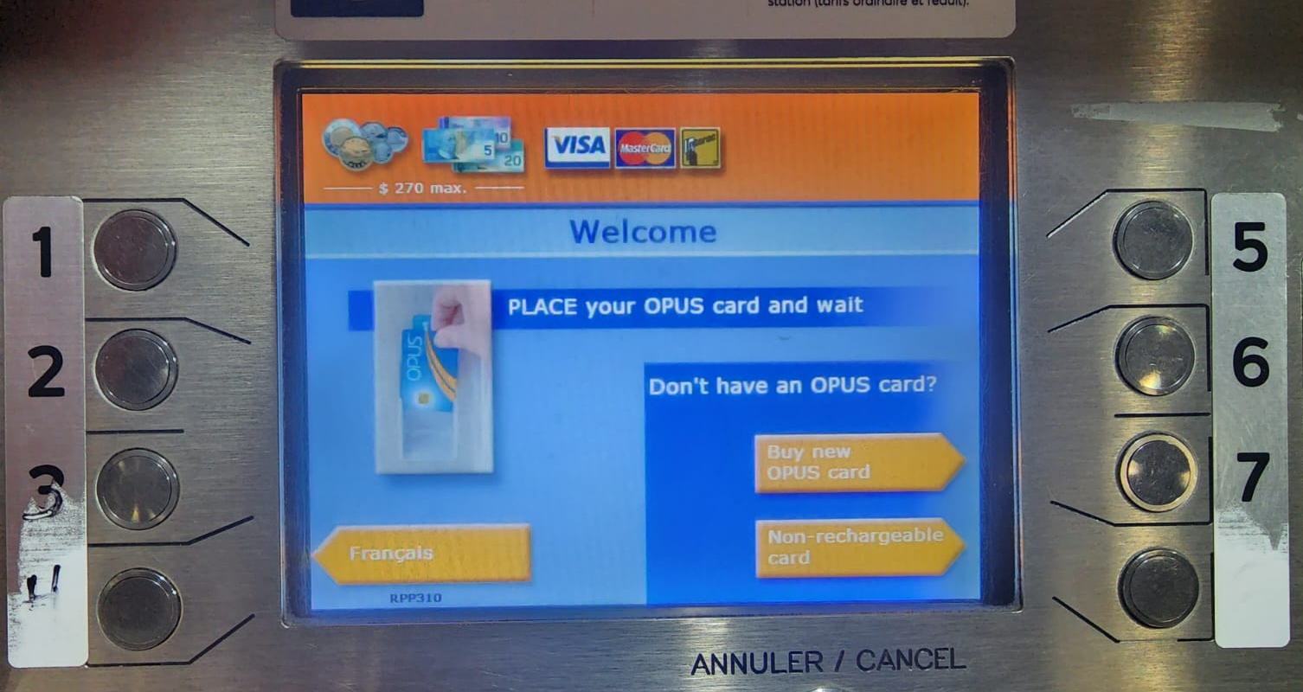
Montreal Transport KIOSK
Two Types of Card:
Hard Plastic
Non-Rechargeable Card
Payment Mode Support:
Any VISA, Master Card or Interac
Cash ($5, $10, $20)
Coin ($2, $1, 5/10/25 cents)

Slide 5
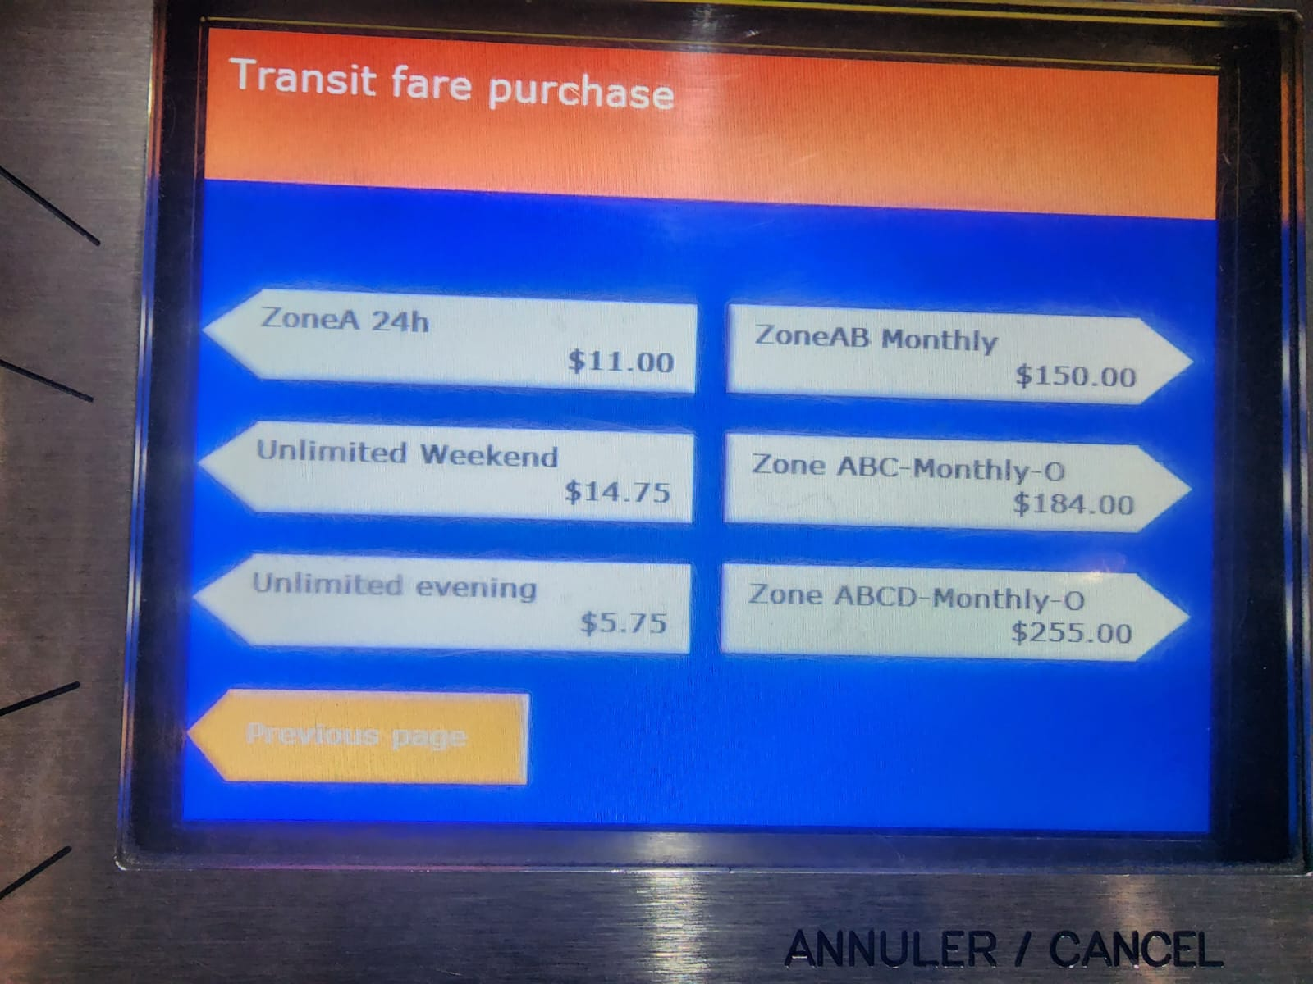
Plastic Card Recharge
Monthly Unlimited
Zone specific 2 trips
Zone specific 1 trip
Zone specific Mon – Sun
Zone specific 10 trips
Zone specific 3 days
Zone specific 24 hours
Unlimited Weekend
Unlimited Evening
Zone AB Monthly
Zone ABC Monthly
Zone ABCD Monthly

Slide 6
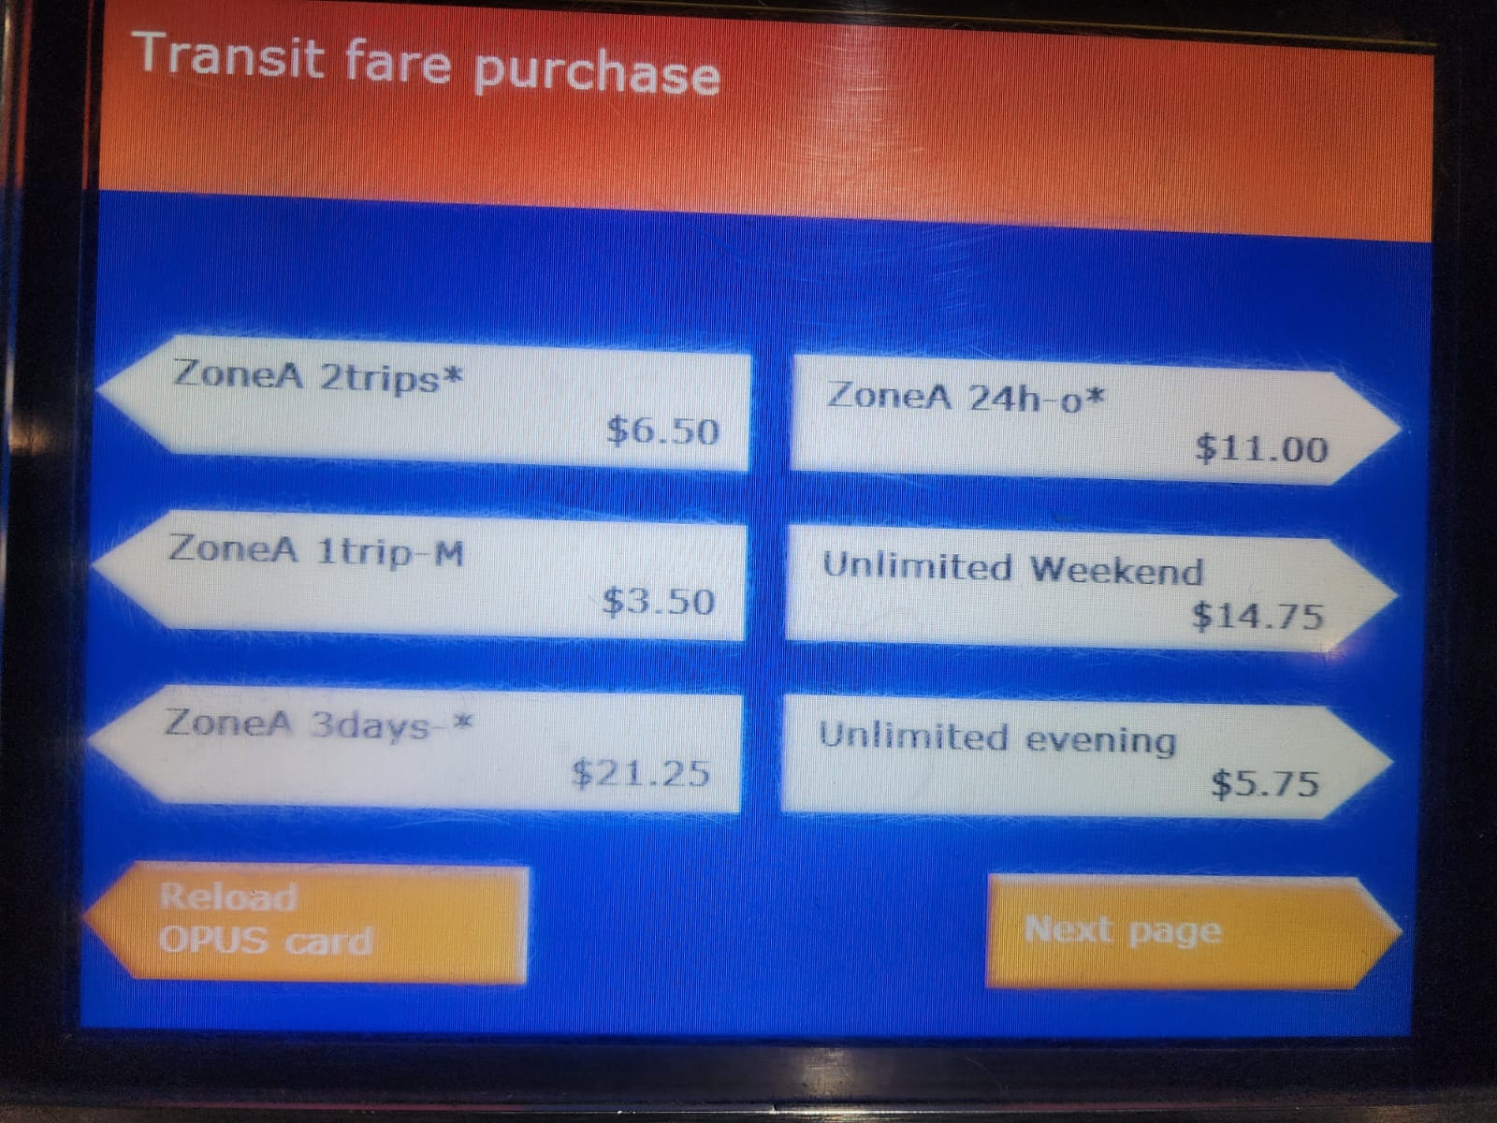
Non-Rechargeable card Options
Zone specific 2 trips
Zone specific 1 trip
Zone specific 3 days
Zone specific 24 hours
Unlimited Weekend
Unlimited Evening
Zone AB 10 trips
Zone ABC 10 trips
Zone AB 2 trips
Zone ABC 1 trip
Zone ABCD 10 trips
STM 6-13 yrs group
And so on…….

Slide 7
Others
Vending Machine Option change from one zone to another
There is an Airport Shuttle with special Vending Machine Option. If anyone doesn’t have OPUS card he/she can purchase from them machine
In few Zone senior citizens get free transport.
See the attachment for the rules for different fares based on various logics.

Slide 8

Interview Questions
Open Ended
Can you describe any issues you've encountered with the current vending machine, such as long wait times or confusing instructions?
What features do you think a new vending machine should have to make the process of buying tickets easier?
How do you typically purchase tickets for the metro? What are some challenges you face in doing so?
Closed Ended
How often do you travel by public transport?
Do you prefer human interaction or machine interaction for purchasing a ticket?
What is your preferred payment method while purchasing a ticket?

Slide 9
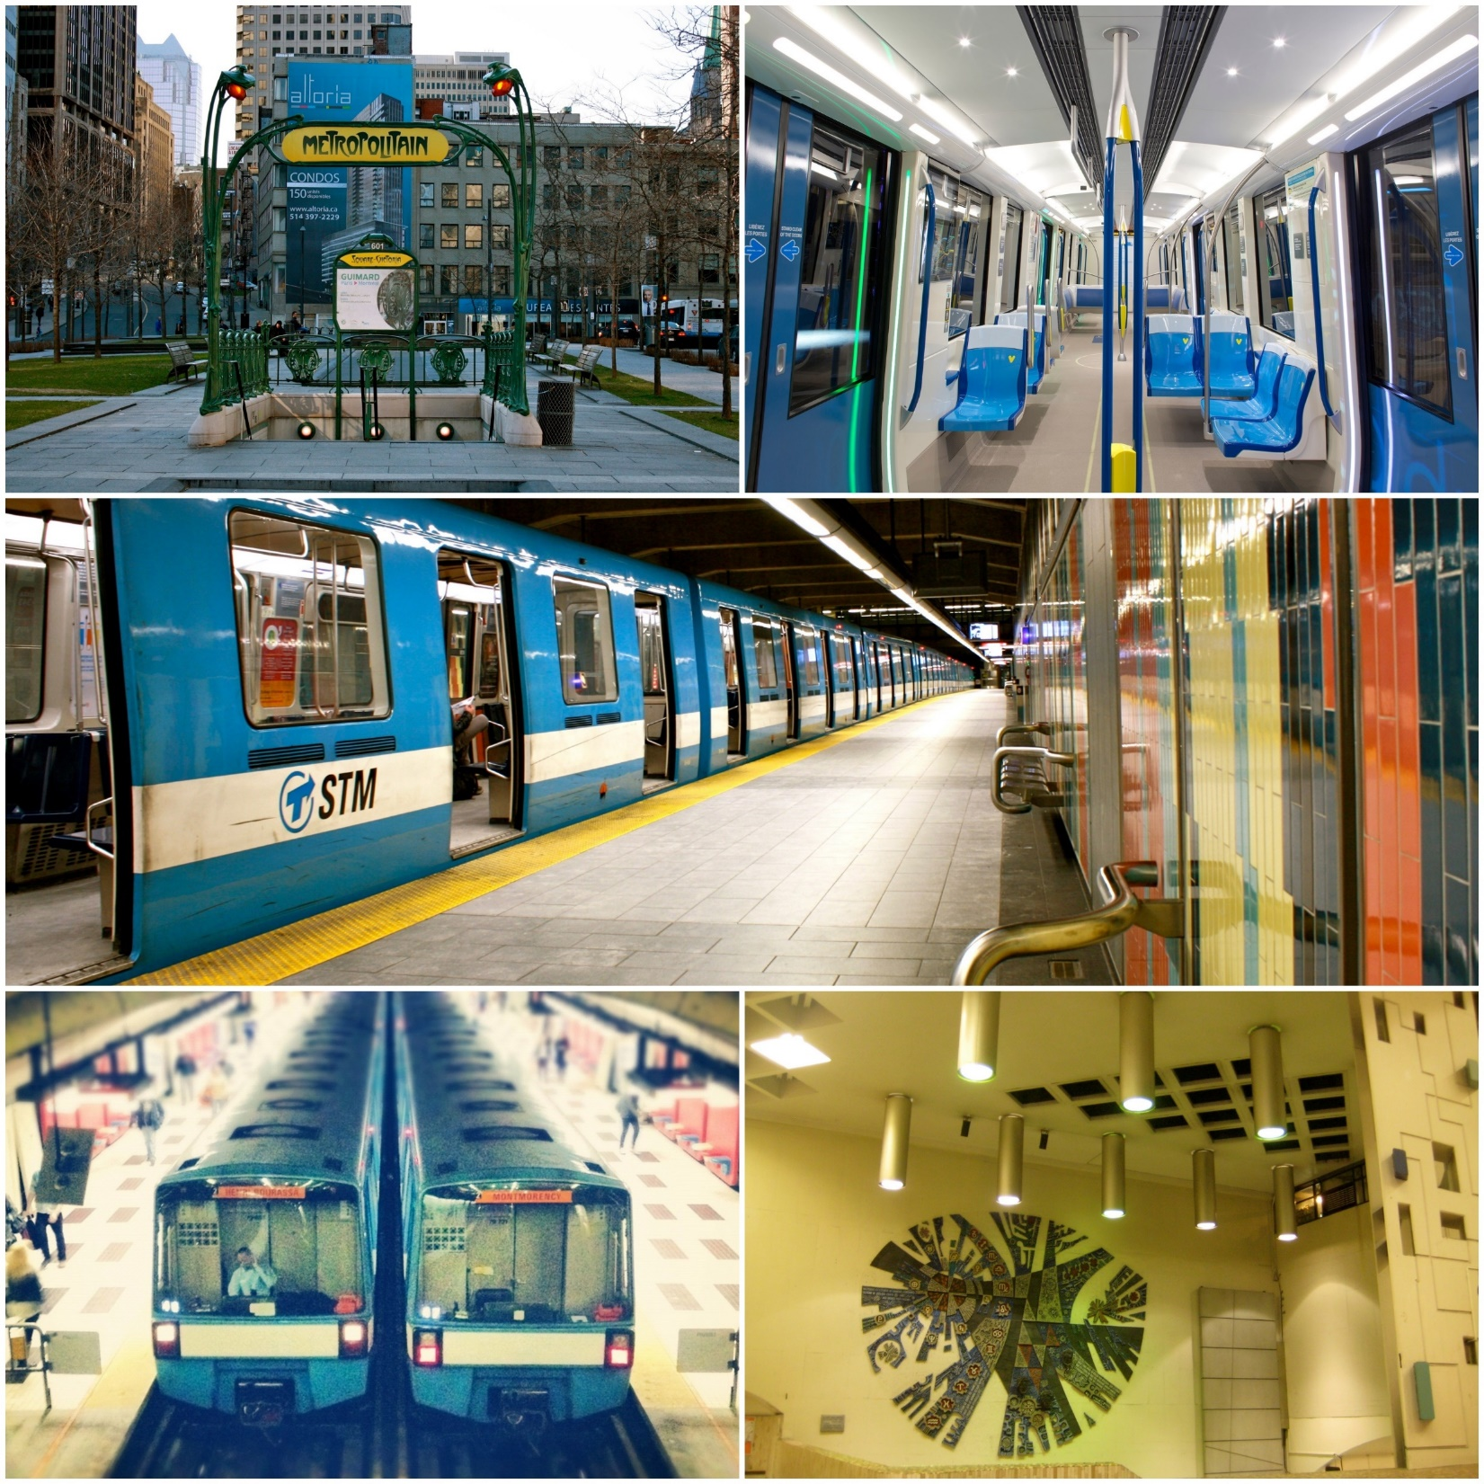
Montreal Public Transport

